Slide 1
Redesigning the Personal Mobility Experience
Senior Capstone Program in Engineering (SCOPE)
Olin College of Engineering & Toyota Motor North America
2019-2020

Slide 2
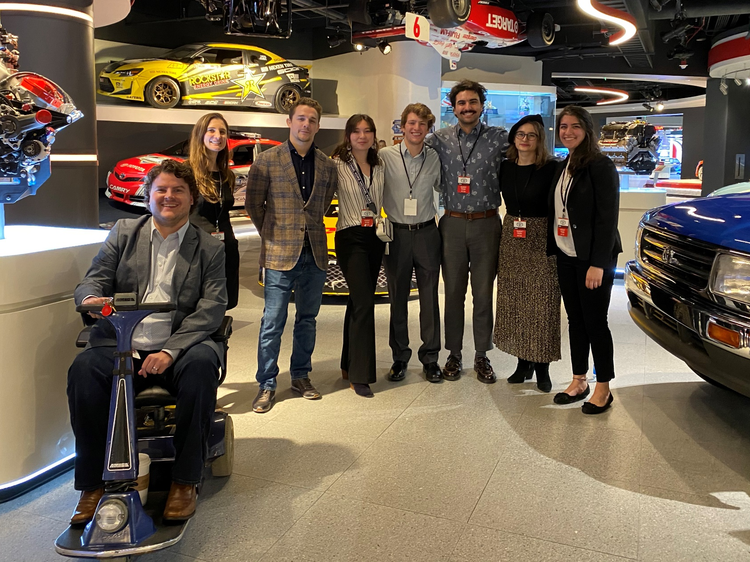
Student Team
Chris Aring, Ava Lakmazaheri, Sophia Nielsen, Siena Okuno, Kian Raissian
Toyota Liaisons
Riley Keen, David Walter, Sarah Darrow, Dario Villarreal
Faculty Advisor
Alessandra Ferzoco

Slide 3
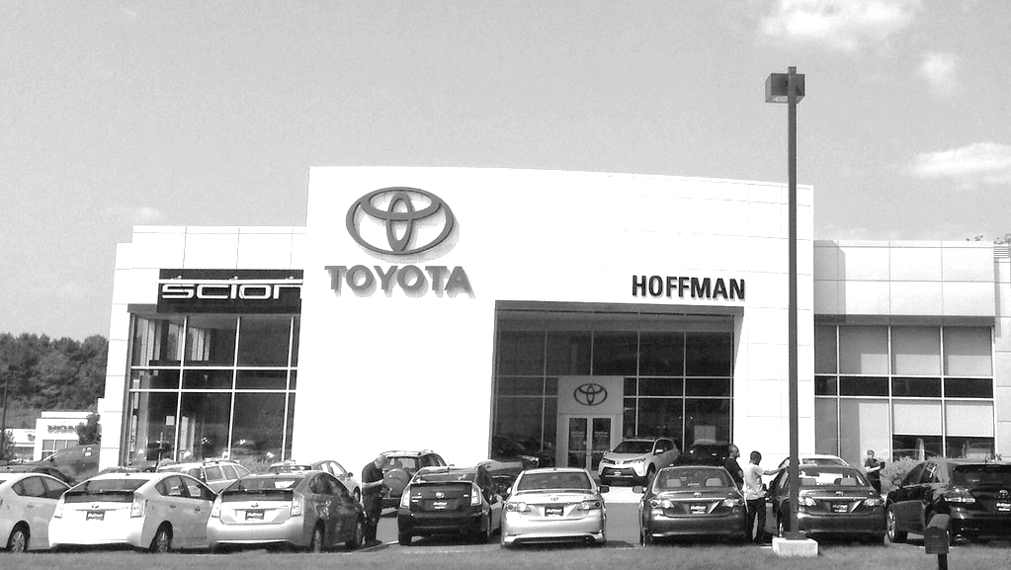
is expanding its role in the mobility community

Slide 4
PROJECT GOAL:
Holistically design a system for power wheelchairs that improves user-chair interaction

Slide 5
90% of PWC users report frustration:
Bumping into low objects
Backing up
Navigating tight spaces
Navigating doorways
2019 Olin SCOPE Survey

Slide 6
Surveyed PWC users state that:
“Control buttons are unintuitive, redundant, and hard to press.”
“There are too many steps in the process just to move the way I want.”
“I wish there were different ways to interact with the system.”
2019 Dallas Abilities Expo

Slide 7
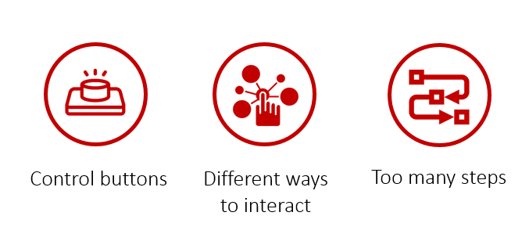
Enhanced Perception
Enhanced Interaction

Slide 8
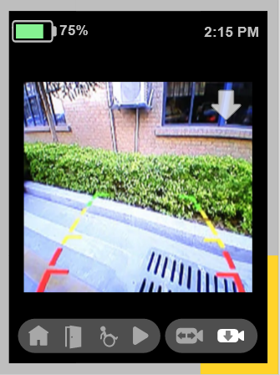
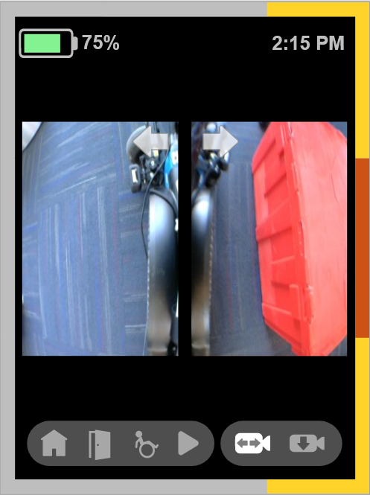
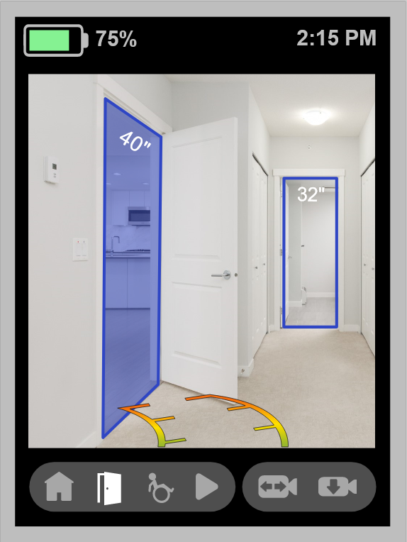
Design for Enhanced Perception
Camera Feeds & Proximity Sensing
Door Detection

Slide 9
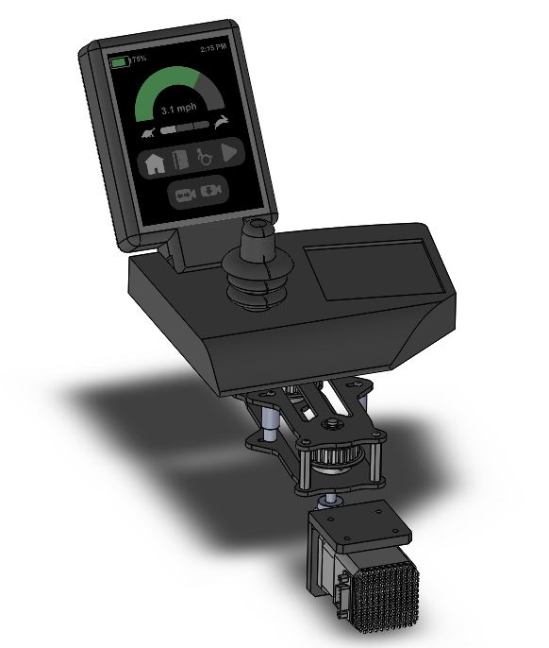
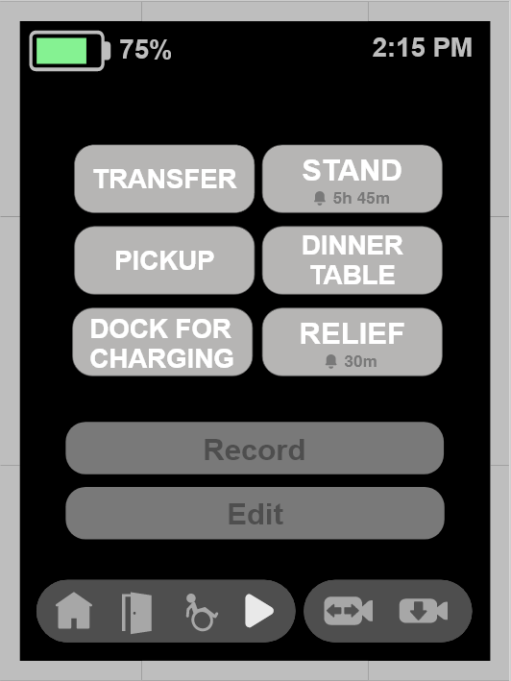
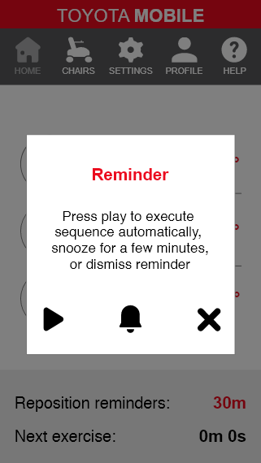
Design for Enhanced Interaction
Physical & Graphical UI
Macro-Programming
Smartphone Integration

Slide 10
PROJECT OUTCOME:
Looks-like and acts-like prototype with design considerations based in repeated user testing

